Slide 1
Titanic - Who Will Survive?
Hyeondeok Cho, Yongjun Cho

Slide 2
Cleaning the data

Slide 3
Procedure
Check the NAN and NULL values in the dataset with isnull() function
We handled the missing values in the ‘Age’ column with KNN imputation.
2-1. The number of missing values in the Age column is about 20% of total number of values. So, if we delete the missed row or replace the values with mean value of total values, the
To detect the outliers, we used Interquartile Range (IQR) method and remove the values larger than upper bound and smaller than lower bound
We changed name of ‘Sex’ column with ‘Gender’ and replaced the ‘male’ value with 1 and ‘female’ value with 0

Slide 4
Explore the socio-economic status

Slide 5
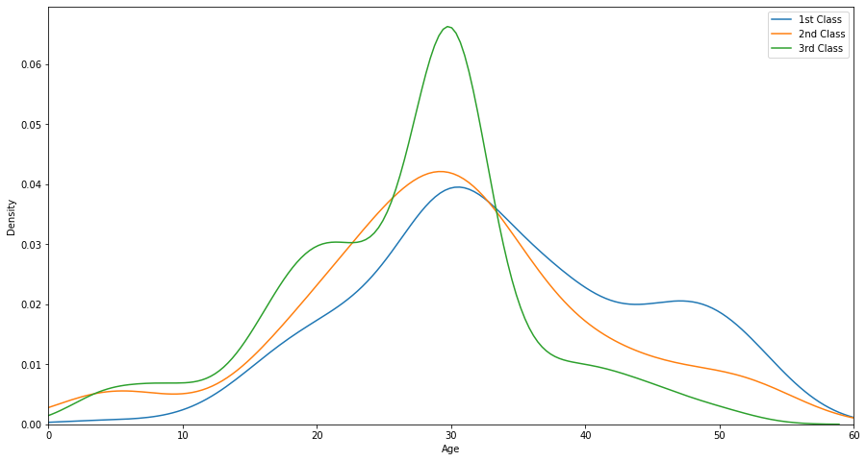
Relationship between pclass and age
According to the figure, we can know that ratio of third class is higher than first class in the age 30s group and ratio of first class is higher than third class in the age 40s to 50s groups.

Slide 6
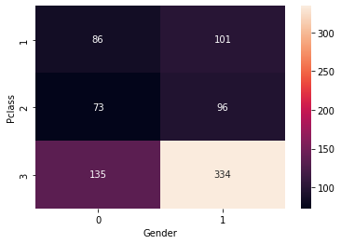
Relationship between pclass and gender
According to the figure, we can know that in the third class, the men were about twice as many as women, and in second and first classes, the number of male has about 20 passengers more than the number of female.

Slide 7
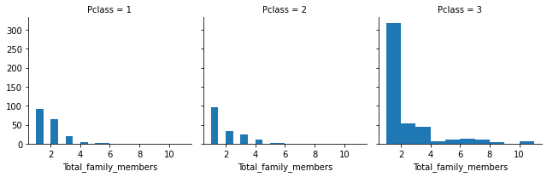
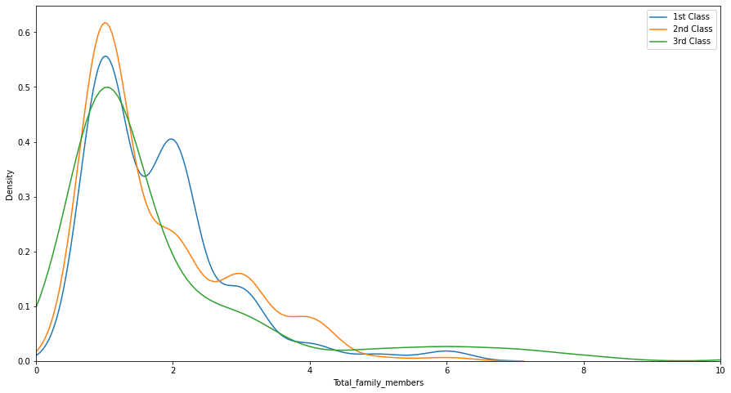
Relationship between pclass and family member
According to the figure, we can know that in the third class, the men were about twice as many as women, and in second and first classes, the number of male has about 20 passengers more than the number of female.

Slide 8
Explore the distribution of survival victims

Slide 9
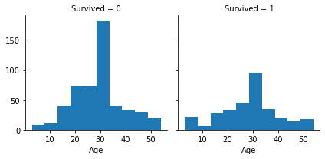
Relationship between survived and age
The number of passengers whose age group is in their 30s represents big portion of total passengers. So, there are a lot of passengers in their 30s who died or survived compared to other age groups.

Slide 10
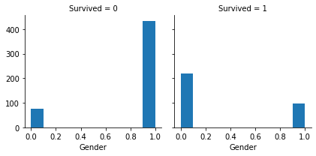
Relationship between survived and gender
In the figure, 1 represents the male, and we can see that lots of the male passengers died. Otherwise, survived rate of female passengers is higher than male passengers.

Slide 11
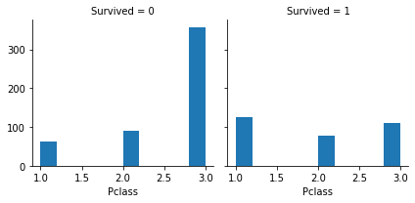
Relationship between survived and pclass
The passengers in the first class died less than other classes and survived more compared to passengers in other classes.

Slide 12
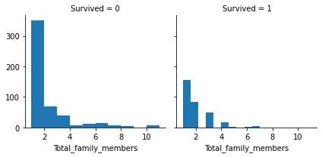
Relationship between survived and total family
We can see that the number of passengers on board alone accounted for a large portion of total passengers. So, the passengers who boarded alone died or survived more compared to others.

Slide 13
What features seem to be the most important ones?

Slide 14
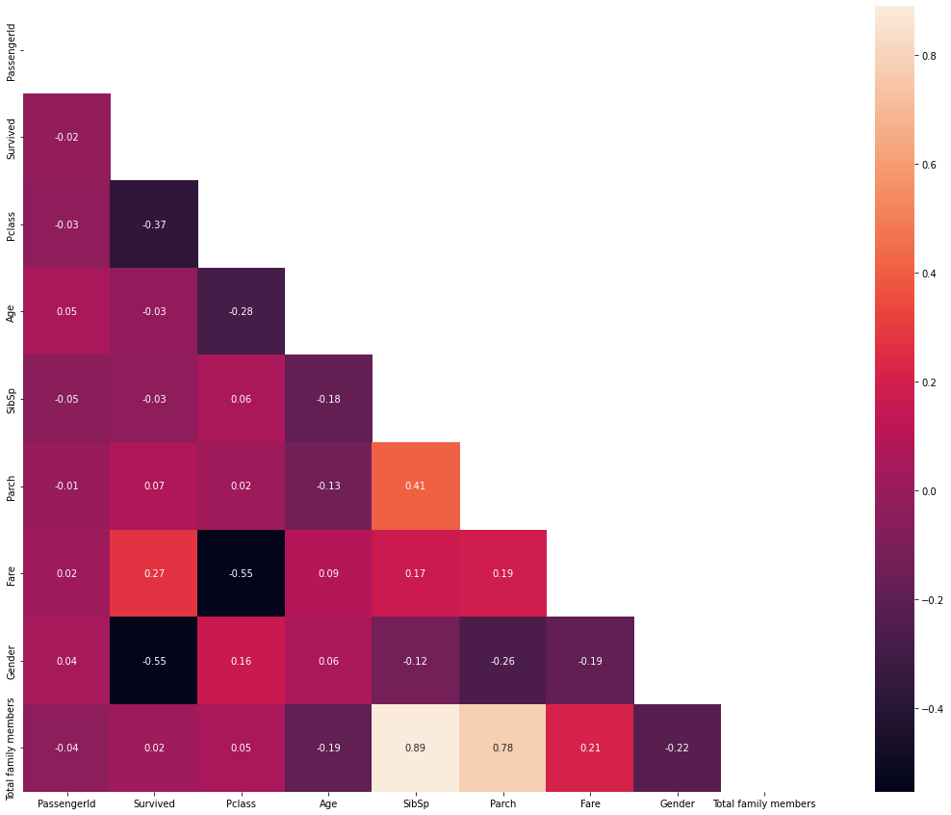
Correlation analysis with Heatmap
We used Heatmap to find correlation with a Pearson correlation method. The Heatmap shows that “Gender”, “Pclass”, and “Fare” are highly correlated with survival. Specifically, “Gender” is the most related factor to survive, and the correlation -0.55 means that survival rate of female is higher than male’s. So, we can use those factors as training and testing features.

Slide 15
Logistic regression model
KNN model
Random Forest model

Slide 16
Step 1: Common Settings
We split the cleaned dataset into test and train. The first 70 rows of the dataset were used as test data and remaining data were used as training data.
‘Gender’, ‘Pclass’, and ‘Fare’ were selected as features, and label was set as ‘Survived’.
Before running the models, the features corresponding to each model were organized using the StandardScaler() function.

Slide 17
Step 2: Evaluation
We used accuracy_score() function to evaluate the performance of each model.
To evaluate each model with different ways, we used f1_score(), recall_score(), and precision_score() functions.
Lastly, we did cross validation for each model to get the score of each model.

Slide 18
Logistic Regression Method
Logistic regression is a method to understand the relationship between a dependent variable and independent variables by estimating probabilities of the variables using logistic regression equation.
Accuracy score: 0.7714
F1 score: 0.7419
Recall score: 0.7667
Precision score: 0.7188
Cross validation score: 0.7868

Slide 19
K-Nearest Neighbor Method
KNN is a supervised classification algorithm in which a new data point is classified based on similarity of other specific group of neighboring data points.
Accuracy score: 0.7714
F1 score: 0.7037
Recall score: 0.6333
Precision score: 0.7917
Cross validation score: 0.8278

Slide 20
Random Forest Method
Random forest is an ensemble learning method for classification, regression and etc., that operate by constructing a multitude of decision trees at training time and outputting the class that is the mode of the classes or mean prediction of the individual trees.
Accuracy score: 0.7429
F1 score: 0.6897
Recall score: 0.6667
Precision score: 0.7143
Cross validation score: 0.8186

Slide 21
Conclusion

Slide 22
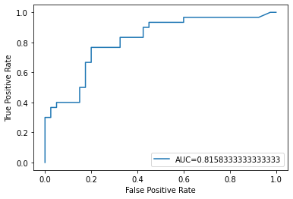
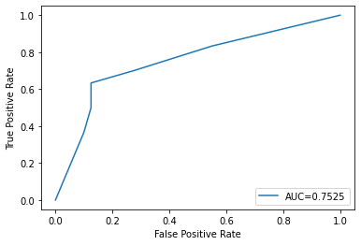

Which one is the best model?
Logistic model
KNN model
RFC model
Based on the ROC curve and AUC value, AUC value of logistic regression model is about 0.82 which is closest to 1. Thus, logistic regression model is better than other models to predict the titanic dataset.

